Slide 1

EDA On Electrical Vehicle Population
EDA On Electric Vehicle Population
Presented by :
Sanskruti Raut
Presented By:
Ms. Sanskruti Raut

Slide 2

Introduction
The electric vehicle (EV) industry is expanding rapidly, transforming global transportation and sustainability efforts.
As adoption rises, understanding market trends, consumer behavior, and regional dynamics becomes critical.
This project leverages real-world EV registration data to uncover key patterns and insights.
The analysis distinguishes between Battery Electric Vehicles (BEVs) and Plug-in Hybrid Electric Vehicles (PHEVs) to profile usage trends.
It explores relationships between vehicle range, price (MSRP), and model year, revealing important performance and affordability dynamics.
Insights from this project aim to guide infrastructure development, policy planning, and business strategy within the growing EV ecosystem.

Slide 3
Problem Statement
The adoption rate of Electric Vehicles (EVs) is accelerating, but regional patterns, vehicle preferences, and infrastructure gaps remain unclear.
Understanding which EV models, makes, and types are leading in adoption is critical for strategic business, government, and infrastructure decisions.
Geographic concentration of EV users demands optimized planning for charging infrastructure and policy incentives.
Lack of structured insights from historical registration data limits opportunities for targeted investments and customer engagement.
Effective data-driven analysis is essential to predict future EV growth trends, inform policy-making, and support the sustainability agenda.

Slide 4
Goal & Objective
Goal :
"To extract actionable insights from Electric Vehicle (EV) registration data to support smart decision- making
for infrastructure, business, and sustainability planning.”
Objective
Analyze Trends: Study EV registration data to identify growth patterns, popular makes, and preferred models.
Understand Geographic Distribution: Map where EVs are most common to guide infrastructure development like charging stations.
Profile Vehicle Preferences: Differentiate between BEV (Battery Electric Vehicles) and PHEV (Plug-in Hybrid Electric Vehicles) usage trends.
Support Strategic Decisions: Enable businesses, governments, and stakeholders to invest smarter based on real data insights.

Slide 5
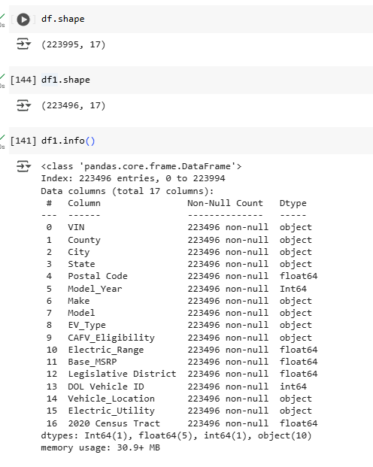
Dataset Overview

Slide 6
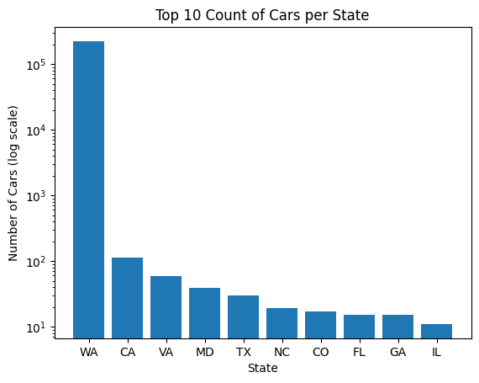
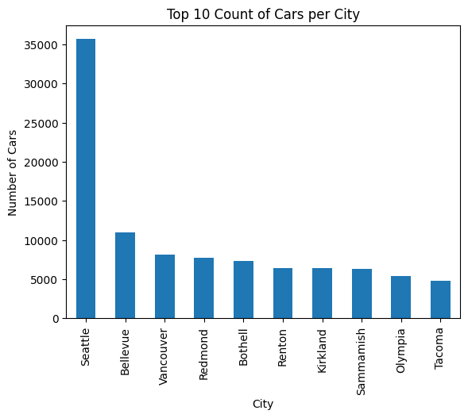
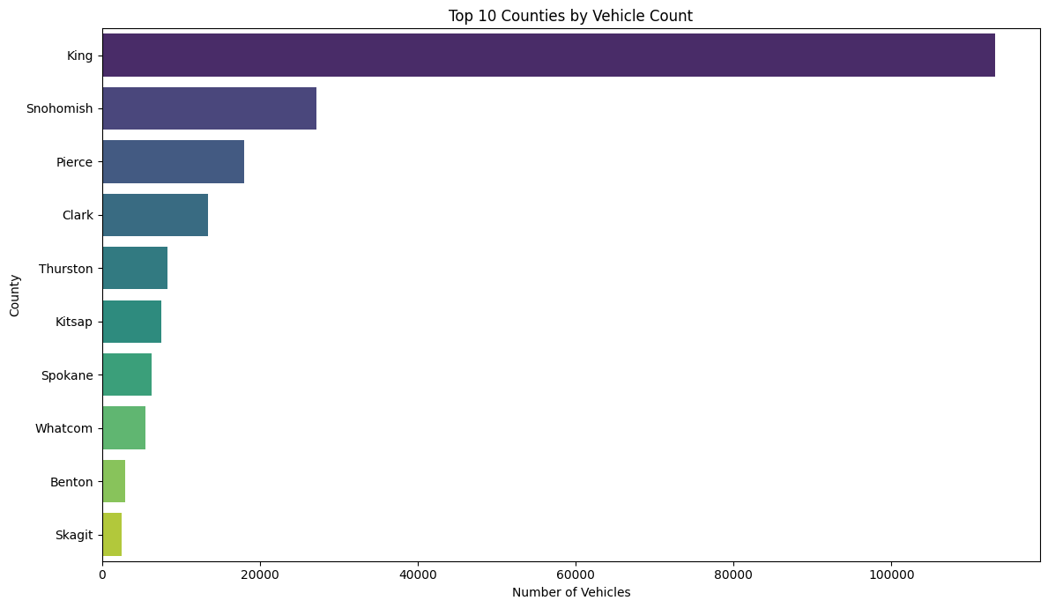
Geographical Distribution
King County has an overwhelmingly large share of EV registrations.
WA shows a significantly higher number of EV registrations.
Most other top 10 states show relatively low EV adoption.
Seattle dominates in EV registrations among the top 10 cities
The EV counts among the remaining cities are comparatively close.

Slide 7
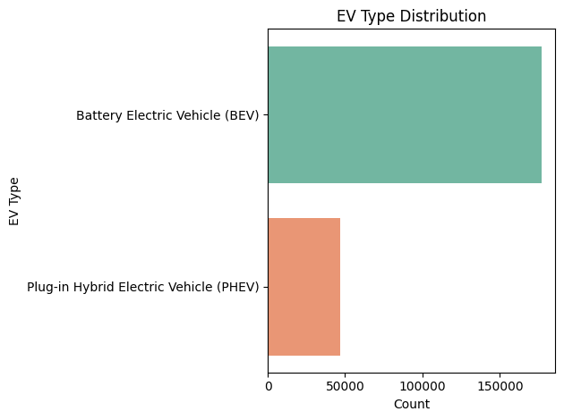
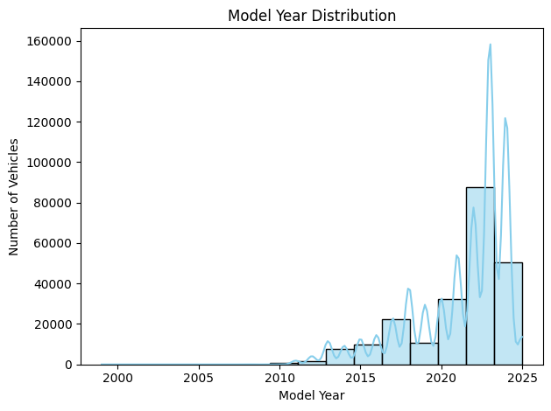
EV Type and Adoption Trends
One EV type (likely BEV) appears to be more prevalent than the other (PHEV)
Minimal Presence Before 2010
Major Growth After 2018
Peak Years 2023-2024
“The expanding EV market, evident in rising registrations in recent years, is primarily driven by the increasing adoption of the more prevalent EV type”

Slide 8
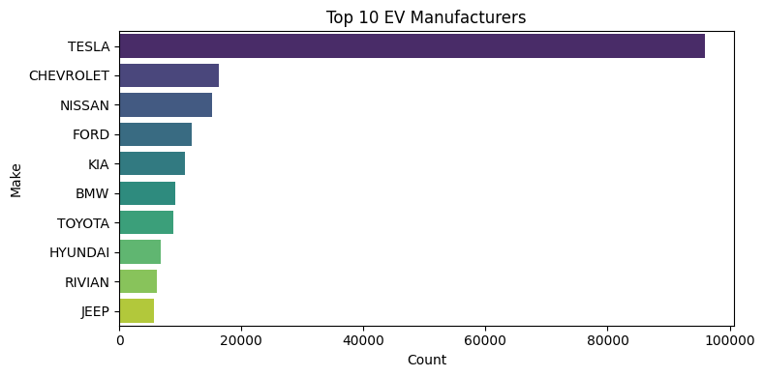
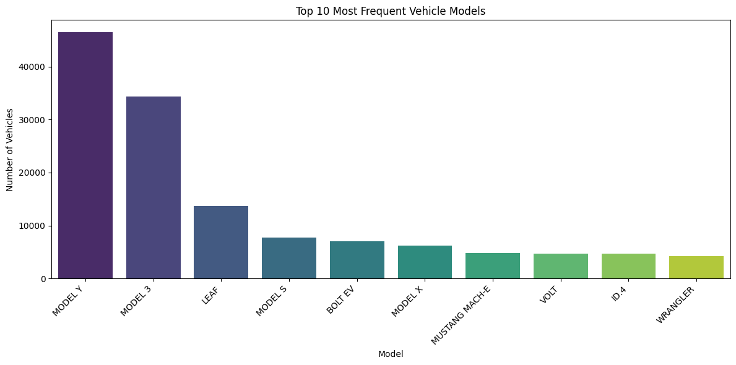
Infrastructure
Tesla is the top Manufacturer
Other manufacturer’s have lower counts
Tesla Model Y & 3 are most frequent
Also, other Manufacturer’s model is in top 10 models

Slide 9
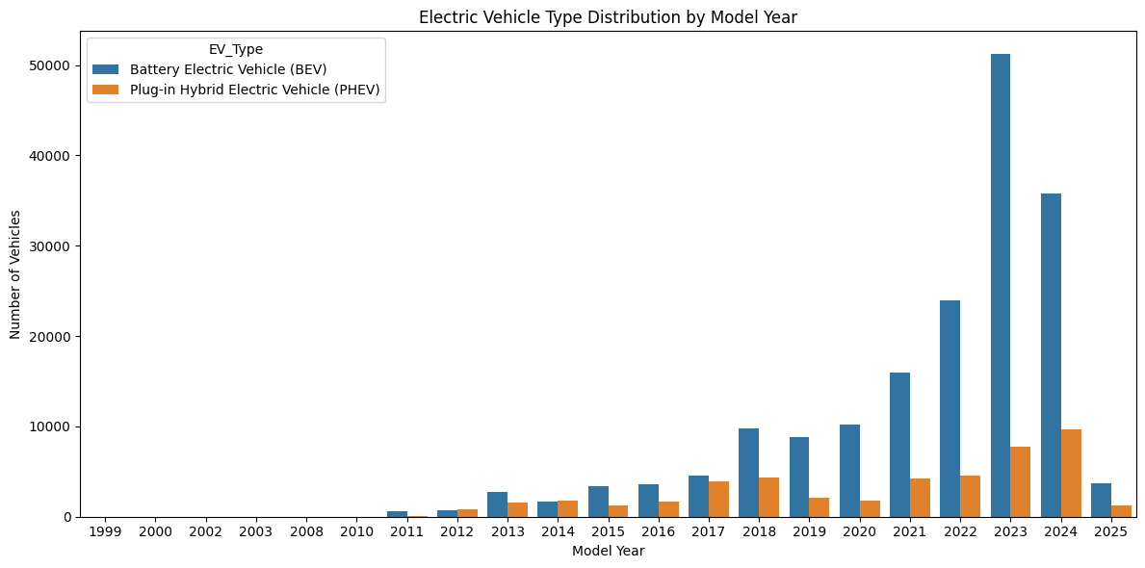
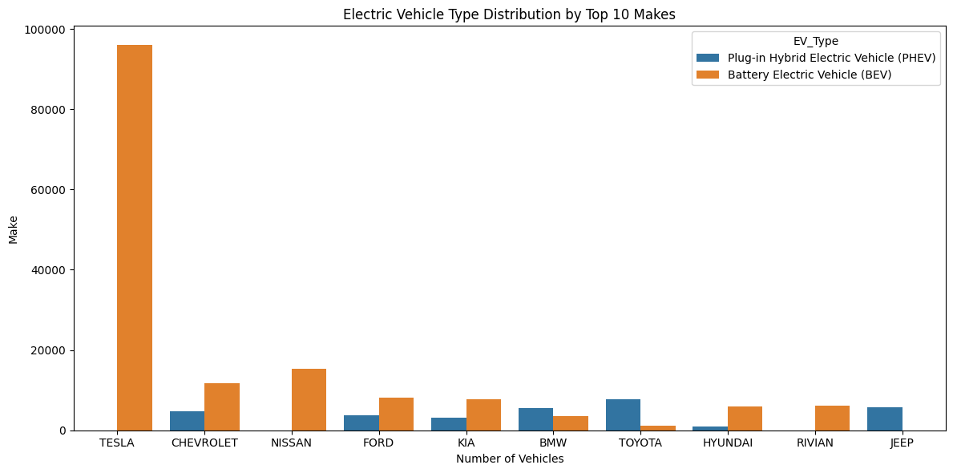
EV Type Trends
BEV Adoption increases significantly in recent years
PHEV adoption is lower than BEV and shows less growth
Tesla Shows a high concentration of BEV sales
Other makes have mixed BEV/PHEV Distribution

Slide 10
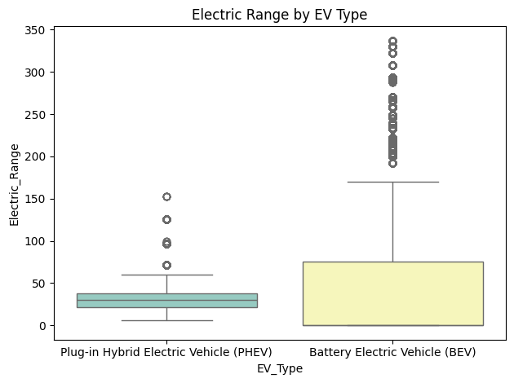
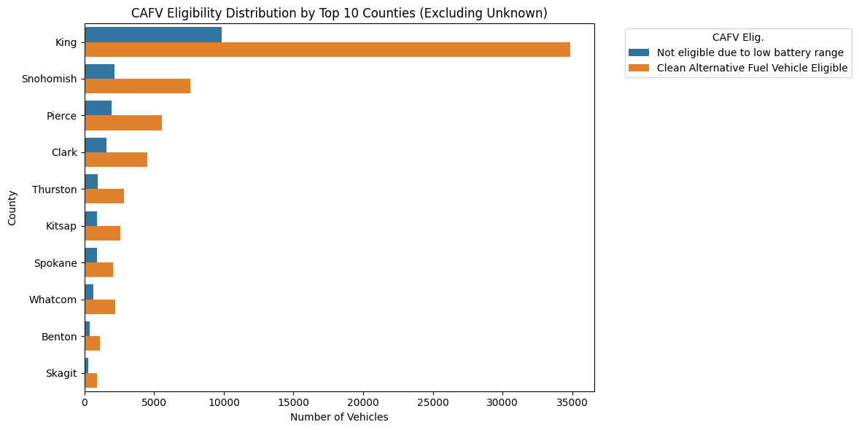
EV Characteristics & CAFV Eligibility
BEVs generally have a higher electric range
PHEVs show a narrow, lower range distribution
King Country has the highest number of both eligible and non- eligible EVs
Most Countries shows more CAFV eligible EVs

Slide 11
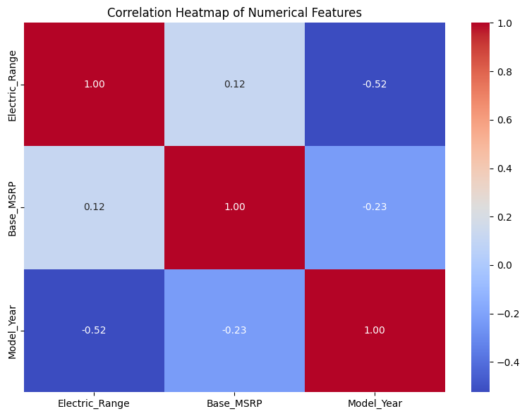
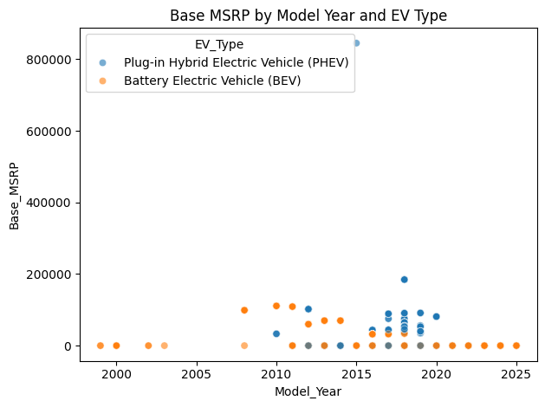
The Interplay of Price, Range, and Model Year by EV Type
Electric Range and Base MSRP show a weak positive correlation (0.12).
Model Year has a moderate negative correlation (-0.52) with Electric Range.
BEVs generally exhibit a wider range of base MSRP values.
The number of available EV models (both BEV and PHEV) increases in later years.

Slide 12
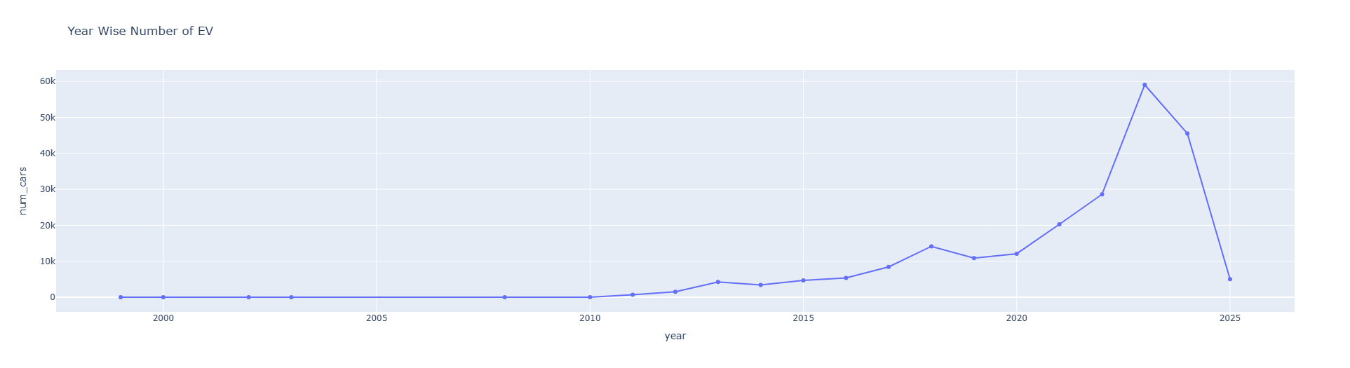
Year Wise EV

Slide 13
Conclusion & Recommendation
Conclusion:
The EV industry has experienced exponential growth in the last decade, especially from 2018 onward, with Battery Electric Vehicles (BEVs) leading this transformation.
Tesla dominates both manufacturer and model rankings, but other brands are gaining ground with broader EV offerings.
Price is not the only driver - many EVs offer high range without being luxury-priced, showing increasing affordability.
EV adoption is highly region-specific, concentrated in counties like King (WA), where infrastructure and incentives are aligned.
A majority of registered EVs are CAFV eligible, reflecting strong alignment between product capability and policy goals.
Recommendation:
Expand Charging Infrastructure in High-Density Regions
Promote BEVs Through Targeted Incentives
Educate Consumers in Low-Adoption Areas
Encourage Affordable High-Range EV Models
Use Data to Drive Policy

Slide 14

THANK YOU

